Slide 1
Decision Tree

Slide 2
Definition
A decision tree is a graphical representation of all possible solutions to a decision.
These days, tree-based algorithms are the most commonly used algorithms in the case of supervised learning scenarios.
They are easier to interpret and visualize with great adaptability.
We can use tree-based algorithms for both regression and classification problems

Slide 3
Case Study
Yesterday evening, I skipped dinner at my usual time because I was busy taking care of some stuff.
Later in the night, I felt butterflies in my stomach. I thought only if I wasn’t hungry, I could have gone to sleep as it is but as that was not the case, I decided to eat something.
I had two options, to order something from outside or cook myself.
I figured if I order, I will have to spare at least INR 250 on it. I finally decided to order it anyway as it was pretty late and I was in no mood of cooking.

Slide 4
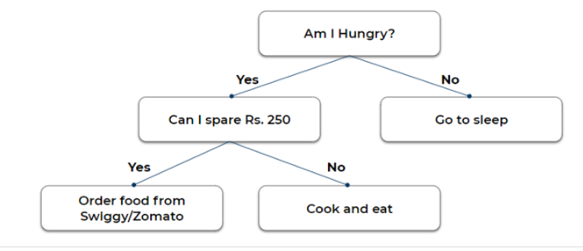
Representation

Slide 5
Note
The purity of the node should increase with respect to the target variable after each split. The decision tree splits the nodes on all available variables and then selects the split which results in the most homogeneous sub-nodes.

Slide 6
Different Ways
1. Gini impurity
2. Chi-Square
3. Information Gain
4. Entropy
5. Reduction in Variance

Slide 7
Gini impurity
Calculate Gini impurity for sub-nodes, using the formula subtracting the sum of the square of probability for success and failure from one. 1-(p²+q²) where p =P(Success) & q=P(Failure)
Calculate Gini for split using the weighted Gini score of each node of that split
Select the feature with the least Gini impurity for the split.

Slide 8
Chi-Square
Calculate Chi-square for an individual node by calculating the deviation for Success and Failure both
Calculated Chi-square of Split using Sum of all Chi-square of success and Failure of each node of the split
Select the split where Chi-Square is maximum.

Slide 9
CHI-SQUARE Formula

Slide 10
Information Gain & Entropy
A less impure node requires less information to describe it and, a more impure node requires more information.
Information theory is a measure to define this degree of disorganization in a system known as Entropy.
If the sample is completely homogeneous, then the entropy is zero and if the sample is equally divided (50% — 50%), it has an entropy of one.

Slide 11

Entropy is calculated as follows.

Slide 12
Steps
Calculate the entropy of the parent node
Calculate entropy of each individual node of split and calculate the weighted average of all sub-nodes available in the split. The lesser the entropy, the better it is.
calculate information gain as follows and chose the node with the highest information gain for splitting
Information Gain=Entropy (p)-Entropy(A)

Slide 13
Reduction in variance
Reduction in variance is an algorithm used for continuous target variables (regression problems).
Used for continuous variables
This algorithm uses the standard formula of variance to choose the best split.
The split with lower variance is selected as the criteria to split the population

Slide 14
Steps
Calculate variance for each node.
Calculate variance for each split as a weighted average of each node variance.
The node with lower variance is selected as the criteria to split.

Slide 15
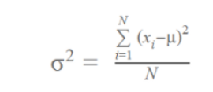
Variance Formula

Slide 16
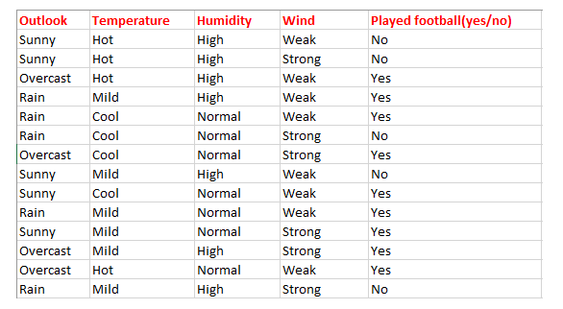
Example

Slide 17
Step-1
Find the entropy of the class variable.
E(S) = -[(9/14)log(9/14) + (5/14)log(5/14)] = 0.94

Slide 18
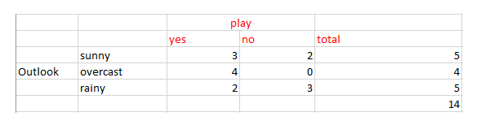
Outlook

Slide 19
average weighted entropy
E(S, outlook)
= (5/14)*E(3,2) + (4/14)*E(4,0) + (5/14)*E(2,3)
= (5/14)(-(3/5)log(3/5)-(2/5)log(2/5))+ (4/14)(0) + (5/14)((2/5)log(2/5)-(3/5)log(3/5))
= 0.693

Slide 20
Information Gain
It is the difference between parent entropy and average weighted entropy we found above.
IG(S, outlook) = 0.94 - 0.693 = 0.247

Slide 21
Other Features
Similarly find Information gain for Temperature, Humidity, and Windy.
IG(S, outlook) = 0.94 - 0.693 = 0.247 (highest)
IG(S, Temperature) = 0.940 - 0.911 = 0.029
IG(S, Humidity) = 0.940 - 0.788 = 0.152
IG(S, Windy) = 0.940 - 0.8932 = 0.048

Slide 22
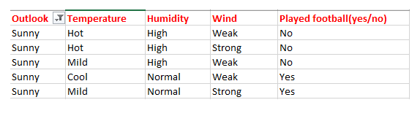
Outlook=sunny

Slide 23
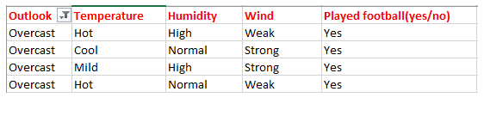
Outlook=overcast

Slide 24
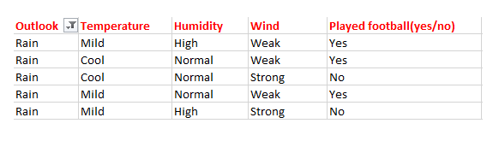
outlook=rain

Slide 25
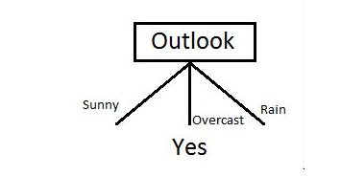
Basic Decision Tree

Slide 26
Now Sunny Becomes Parent Node
E(sunny) = (-(3/5)log(3/5)-(2/5)log(2/5)) = 0.971

Slide 27
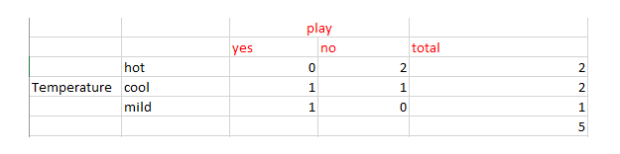
Now Calculate the information gain of Temperature. IG(sunny, Temperature)

Slide 28
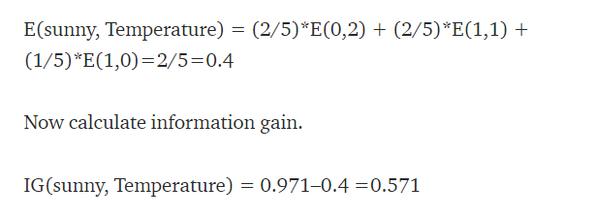
Entropy and Information Gain

Slide 29
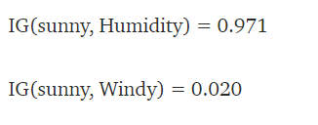
Other features

Slide 30
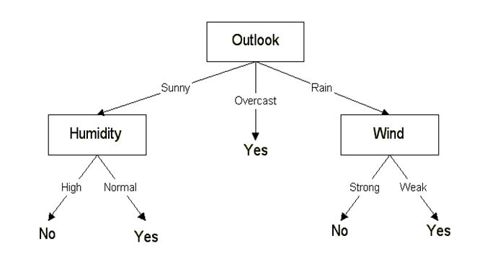
Final Decision Tree

